Slide 1

Assessing Time-Series Relationships Between South Korean KOSPI and U.S. NASDAQ
Jason Yoon
Joel Laskow
https://www.washingtontimes.com/news/2022/jul/6/us-south-korea-relations-and-a-strategy-for-the-in/
Notes:
Hello. We are Jason and Joel for the final project of time series class and we want to forecast domestic stock market using foreign countries stock indices.
We assume that the domestic stock index is highly correlated with foreign countries stock indices due to the global corporate governance.
Here we want to focus on the KOSPI index from South Korea and NASDAQ index from the United states.

Slide 2

A Long History
Deep ties to U.S. established since earliest days of South Korea
Military and economic pressures have propelled cooperation between nations
South Korea is now one of the leading trading partners with the U.S.
Notes:
South Korea and United states have been deep ties after world war 2nd in the aspect of democracy, economics and defence for near 80 years.
Now we want to see how they cooperates in business using representative stock market indices of KOSPI and NASDAQ.
Jason

Slide 3
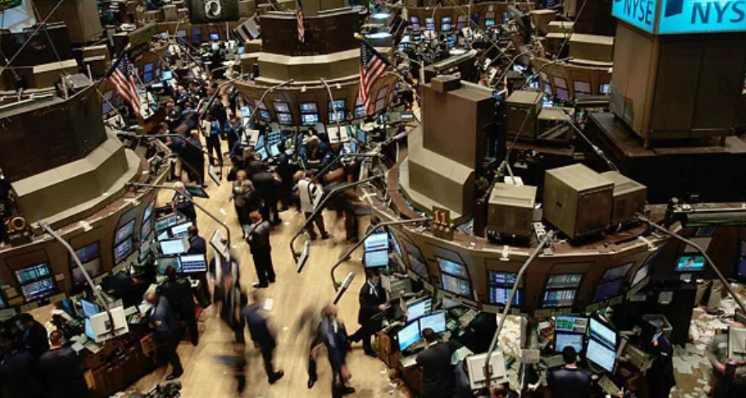
Trading Terms
Securities: A fractional ownership of a company’s assets (stocks)
https://batman-news.com/2011/02/11/the-dark-knight-rises-big-scene-at-the-nyse/
NASDAQ: A leading securities market in the US
KOSPI: South Korea market similar to US NASDAQ
Notes:
Here we want to introduce trading terms for securities as stocks, NASDAQ and KOSPI.
Jason

Slide 4
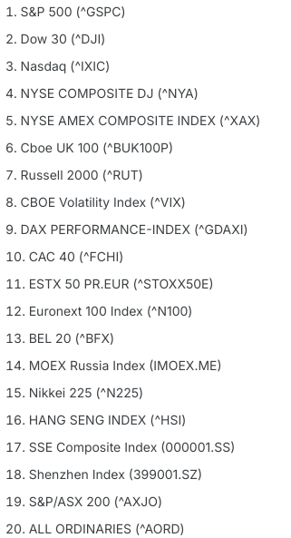
Trading Terms
Securities: A fractional ownership of a company’s assets (stocks)
NASDAQ: A leading securities market in the US
KOSPI: South Korea market similar to US NASDAQ
Similar markets exist around the world
Notes:
And other country’s stock market indices
Jason

Slide 5
Project Outline
KOSPI and NASDAQ
Data Exploration
2) Univariate Models
3) Multivariate Models
4) Neural Networks
5) Ensembling
Notes:
Here is our contents for this project.
Jason

Slide 6
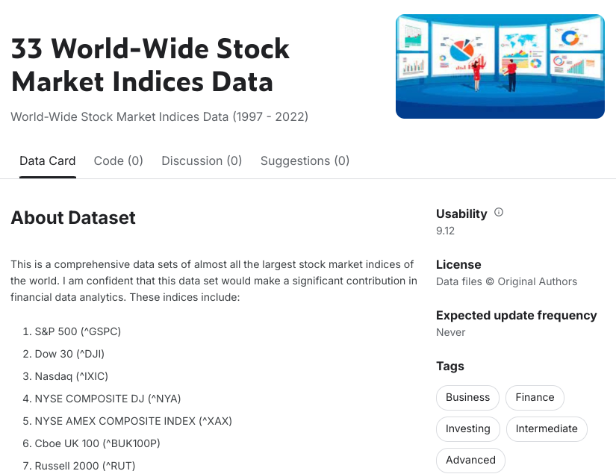
Stock Data (12/31/1996 -11/08/2022)
33 World-Wide Stock Market Indices Data
Author: Mukhazar Ahmad
Contains:
Date
High
Low
Open
Close
Volume
Adj Close
https://www.kaggle.com/datasets/mukhazarahmad/worldwide-stock-market-indices-data
Notes:
We want to use 33 world wide stock market indices data from kaggle and it contains date, high, low etc. We will forecast longterm(1 year) and short term (30 days) prediction out of 6 years stock market data here.
Joel

Slide 7
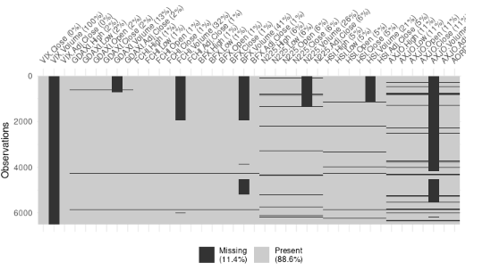
Data Cleaning
Snapshot of dataset, columns 41 -80
NA Values Throughout Dataset
Notes:
We want to check the data quality to see how much NA values in there.
Joel

Slide 8
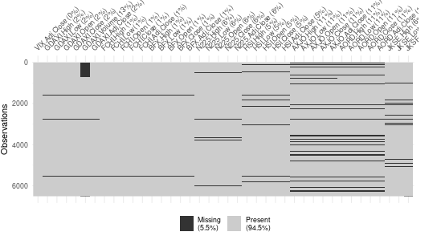
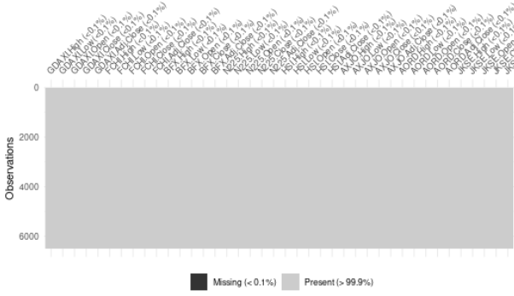
Data Cleaning
Removed columns with NA>12%
Rolling mean (k=3) imputed to remaining NA values
Remaining NA values were omitted
Notes:
We use rolling mean imputing to fill up the NA values after removing columns with NA>12%
Joel

Slide 9
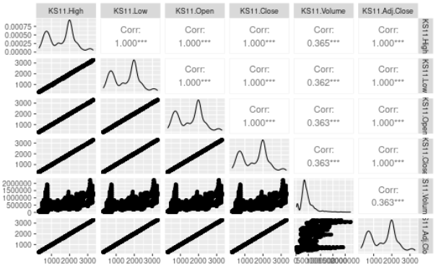
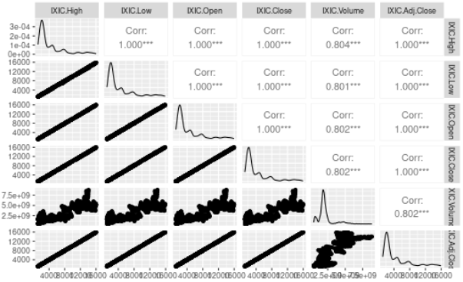
Variable Selection
IXIC (US Nasdaq) and KS11 (South Korea KOSPI) attributes selected
2) Attributes further reduced to Open and Volume to
address multicollinearity
Notice Open displays collinearity with all variables except Volume
Notes:
We select IXIC and KS11 for our interests and see how they correlated. Also we want to
Joel

Slide 10
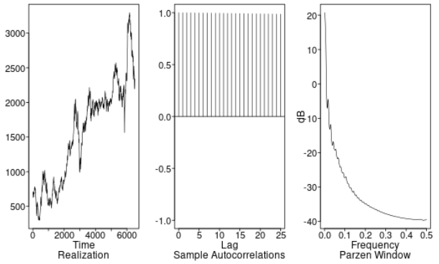
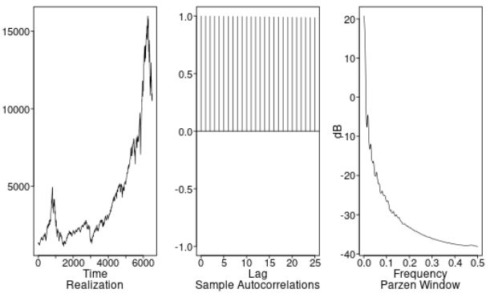
Non-Stationary Opening Behavior
KS11 (Open)
IXIC (Open)
Notes:
Wondering behavior
Joel

Slide 11
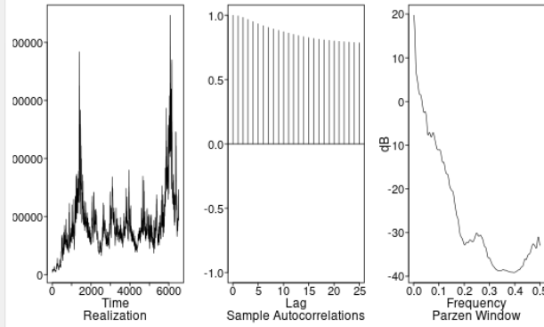
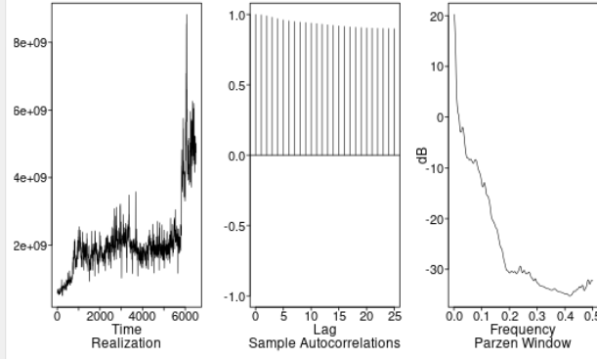
Non-Stationary Volume Behavior
KS11 (Volume)
IXIC (Volume)
Notes:
Wondering behavior
Joel

Slide 12
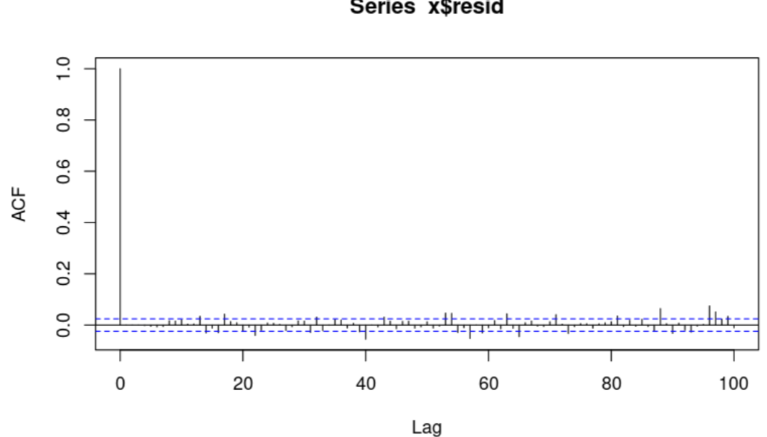
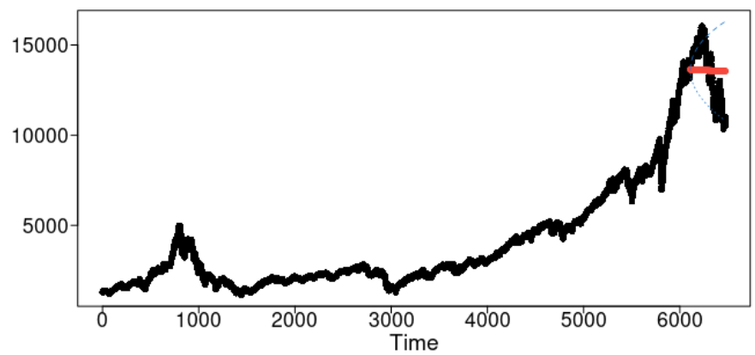
Univariate Models
ARMA(6,4):
Residual Tests:
Visual:
Some evidence of signal left over
Ljung-Box:
K=24:
Pval = 0.000131291
K=48
Pval: 1.50379E-8
It might be possible to build a univariate model that captures a better signal.
Long term Square Root ASE: 1581
Short term Square Root ASE: 225
Notes:
Here I want to start with univariate model for nasdaq opening forecasting. After aic5 model selection in TSWGE package, the ARMA 6,4 model is selected for the best AIC value. Here is the longterm forecasting with red solid line whose ASE is 1581. Also short term square root ASE is 225.
Jason

Slide 13
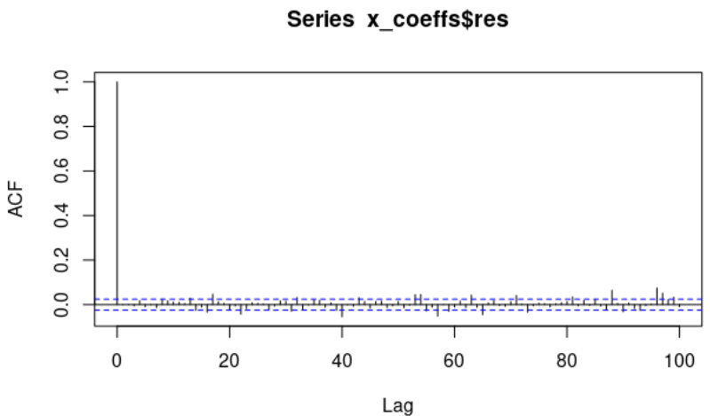
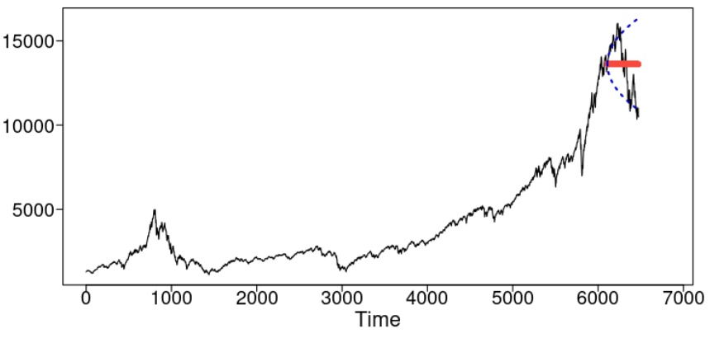
Univariate Models
ARIMA(1,1,5):
Residual Tests:
Visual:
Some evidence of signal left over
Ljung-Box:
K=24:
Pval = 0.00002171663
K=48:
Pval = 1.63709E-9
ARIMA model performed almost identically to the ARMA model
Long term Square Root ASE: 1630
Short term Square Root ASE: 266
Notes:
After differencing trending term, the arima 115 model is selected to the best BIC value. The Ljung-Box test is rejected with p value less than .05 after differencing trending term and the yearly or quarterly seasonal term can be considered to meet the Ljung-Box test.
Jason

Slide 14
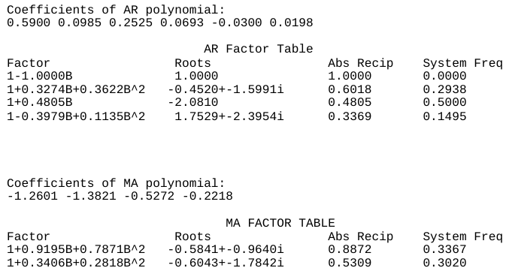
Final Univariate Model
ARMA(6,4)
Notes:
Here the final univariate model to forecast nasdaq opening data is ARMA 6,4 model and the coefficients are displayed in polynomial and back shift notation.
Jason

Slide 15
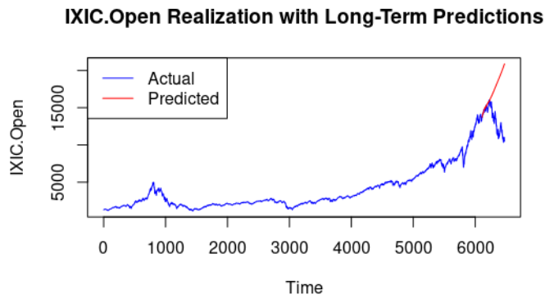
Multivariate VAR
Tracked Variables:
IXIC.Open
KS11.Open
IXIC.Volume
KS11.Volume
Short Term Square Root ASE: 494.6905989655
Long-Term Square Root ASE:
5081.541425
Notes:
Joel

Slide 16
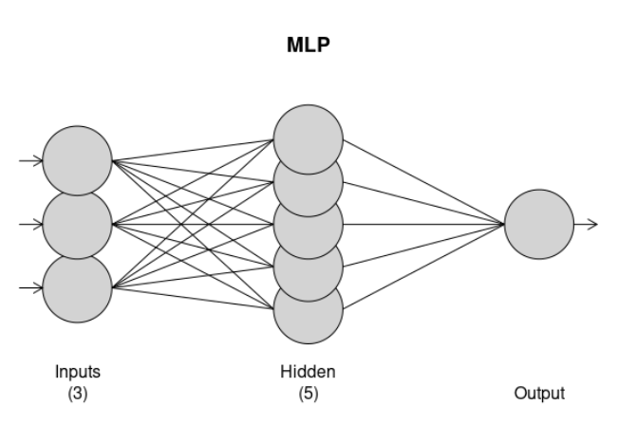
Neural Network
(IXIC.Open)
Neural Network complexity was limited by system resources. Models with additional variables would crash.
Resources Available:
16 GB Memory
4 CPU Allocated (R Cloud)
Short Term (30 Days) | Long Term (365 Days)
ASE: 1524187 Square Root ASE: 1234.58 | ASE:6949802 Square Root ASE: 2636.248
Notes:
Joel

Slide 17
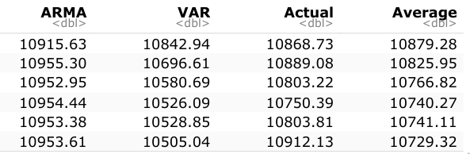
Mean Ensemble
2 Models Chosen for Ensemble:
ARMA
VAR
Bootstrapping to Monitor Performance
Short-Term Square Root ASE (30 days): 213.8581
95% Confidence Interval for Short Term: (170.7206, 252.262)
Long-Term Square Root ASE (365 days): 3144.388
95% Confidence Interval for Long Term: (2935.582, 3359.875)
Notes:
Joel

Slide 18
Short-Term Performance Comparison
* 95% Confidence Intervals
Model | Root ASE | Lower | Upper
Univariate ARMA | 258.6433 | 195.5608 | 314.4016
VAR (IXIC + KS11 + Volume) | 494.6906 | 383.7788 | 528.87
Ensemble | 213.8581 | 170.7206 | 252.262
Ensemble out-performs individual models in short-term
Notes:
For the evaluation of model performance to predict nasdaq data, we want to compare the root ASE for the univariate ARMA, VAR and Ensemble model. Here the Ensemble model is out performed in short term forecasting.
Jason

Slide 19
Long-Term Performance Comparison
* 95% Confidence Intervals
Model | Root ASE | Lower | Upper
Univariate ARMA | 1610.665 | 1537.771 | 1684.213
VAR (IXIC + KS11 + Volume) | 3731.627.7 | 4087.146.319 | 3376.108
Ensemble | 3144.388 | 2935.582 | 3359.875
Univariate outperforms VAR and Ensemble in Long-Term
Notes:
The long term ASE is higher than short term as expected. Here the best model is Univariate ARMA model who has lowest root ASE and Ensemble, VAR model due to the model complexity and cross correlation between nasdaq and kospi data.
Jason

Slide 20
Conclusion
Limited predictive relationship identified with present models between IXIC and KS11
Limitations:
Processing Power
Limited data available (only price data and volume data)
Findings and Applications:
Ensembling provides better performance overt just VAR or ARMA in short term, but not in long term.
In the short term, investors can ensemble predictive models to generate predictions that capture potential market trends, however they should be wary of long-term predictions extending beyond 30 days
Our models grossly underestimated the price for conservative investment portfolio, leaving considerable room for improvement with more advanced (Complex Neural Network) models
Notes:
Joel

Slide 21
Future Projects
Bolster processing power
Access to stronger CPU and Memory capabilities might improve processing performance
HPC Parallel Computing through SMU
Great processing speed and performance allows for more robust models
Alternative packages with distributed processing potential (Pytorch)
Once processing constraints are addressed:
Build multivariate models with markets from additional countries (33 available in the dataset)
The more markets tracked, the more potential predictive power
Notes:
HPC from SMU
Univariate model for ARIMA with yearly or quarterly differencing.
Lag selection for VAR model. Other countries data included.
MLP model: Pytorch more scaleable from Professor Nikos Kourentzes at university of Skovde
Jason

Slide 22
Thank You
Joel Laskow
LinkedIn:
www.linkedin.com/in/joel-laskow-10575b91
Github:
https://github.com/jlaskow
Jason Yoon
LinkedIn:
https://www.linkedin.com/in/gwonchanjasonyoon
Github:
https://github.com/gwonchan
Kaggle:
https://www.kaggle.com/code/jasongyoon/tswge-and-var
Notes:
Multivariate models in the kaggle search tswge

